Slide 1
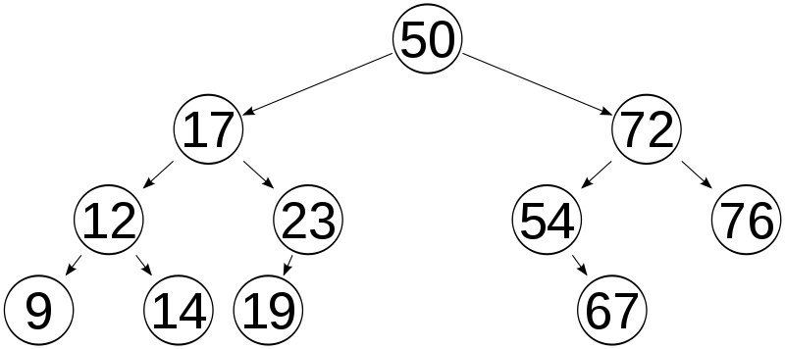
BST: Binary Search Tree
Only “keys” are shown;
Values are not shown
Kurt Friedrich
Spring 2015

Slide 2
Trees: used for storing hierarchical data
https://msdn.microsoft.com/en-us/library/ms379573(v=vs.80).aspx
A tree is a data structure that consists of nodes, where each node has some value and an arbitrary number of children nodes. Trees are common data structures because many real-world problems exhibit tree-like behavior. For example, any sort of hierarchical relationship among people, things, or objects can be modeled as a tree.
A binary tree is a special kind of tree, one that limits each node to no more than two children. However it has no “order”.
A binary search tree, or BST, is a binary tree whose nodes are arranged such that for every node n, all of the nodes in n's left subtree have a value less than n, and all nodes in n's right subtree have a value greater than n.
Can be used for example, to implement a Dictionary of any type.

Slide 3
We left off with Big O of LL
Other than the trivial top of the list operations, all the other methods operated in
BIG O :: O(N) aka Linear Time
If we want to insert in order, print a particular list item, or search for one, we have to walk the entire list.
Probability says on average it will be ½ the tree, but the point is, if the tree is twice as long, it will take these operations, on average, twice as long.
Can we do better?

Slide 4
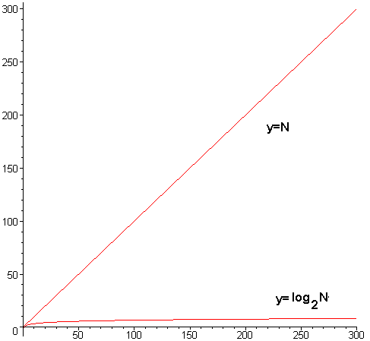
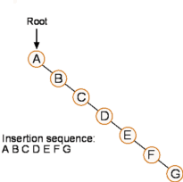
BSTs - offer sublinear running time for insertions, deletions, and searches. This is because when searching for a node in a BST, each single step down the tree reduces the number of nodes that need to be potentially checked by one half. That’s what O log2 N looks like!
However, in the worst-case their asymptotic running time is reduced to linear time. This happens if the items inserted into the BST are inserted in order or in near-order. In such a case, a BST performs no better than an array. So in actual practice, the performance is not quite as good as log2 N, but it is far better than O(N), and if used with random data, it is close to log2 N.
There are “self-balancing” BSTs (AVL trees and red-black trees); but we won’t cover.

Slide 5
We will Implement recursive and non-recursive algorithms to manipulate binary search trees.
construct,
insert,
delete,
search,
traverse

Slide 6
Implementing a BST 1-Find Program – Our first BST
Just like LL, we will have a class that manages the BSTnode node objects and it will contain
bstTop A ref object ( ~pointer) to the first node, the top node. Or else it will be null, saying the tree is empty
The methods to
insert,
delete,
search
Print
etc

Slide 7
Each node will be an instance of a private “nested” node class
Each node object has
BSTnode LeftNode a ref object = the next left object and BSTnode RightNode another ref object = the next right object (again, these can be = null, meaning bottom of branch)
Easy to think of these as pointers, but as objects are by ref, they “are” the next nodes!
int bstKey; A “key”, sort of the “name” of the node, which we will use to keep them in order and find them. The key could be a string, or whatever serves your need, we will be using an int
A “value” holding whatever it is you are storing in the nodes, an int, a string, or a complex object. Our example will not have this!

Slide 8
BST: Binary Search Tree
bstTop
L
R
L
R
L
R
L
R
L
R
L
R
L
R
L
R
L
R
L
R
L
R
L
LeftNode Ref
R
RightNode Ref
bstTop (all 3 are of type node objets)

Slide 9
Shape of the BST, after adding 10, 5, 15, 7, 12
10
5
15
7
12

Slide 10
Shape of the BST, after adding 20, 12, 30, 10, 15, 2
20
12
30
10
15
2

Slide 11
Shape of the BST, after adding 20, 2, 12, 30, 10, 15
20
30
2
12
15
10

Slide 12
1-Find Program – Our first BST
Add method to add new node
public void Add(int keyParam)
If bstTop has a value of null, the tree is empty
Create a new node, and have bstTop reference it.
The newly created node will auto default to null for its left and right references, which is good, there are no other nodes on the left and right
If not, we need to start walking the left and right side of the tree to find the correct place to insert a new one with the key value set to keyParam

Slide 13
Walk tree
Create a pointer, reference node the we will update to point to the next node, then the next node, over and over until we are at the right location
Use a While(true) infinite loop, that we will “break” out of when we get down the tree to the right place to do the insert
Set up a if if else else structure
if is for the case when the keyParam is less than the current.bstKey (need to walk to the left)
if else is for the case when the keyParam is more than the current.bstKey (need to walk to the right)
else tests for a keyParam is == to current.bstKey, meaning we are trying to add a node with a duplicate key, throw an error (or you can implement a BST that allows duplicates, but they are messy)

Slide 14
If we went left,
See if our pointer (current) left node pointer is null. If it is, that means there are no lower values to the left, so we will create a new node and insert the new node there.
If it was not null, then we will take another step down the left, by updating our current pointer to point to current’s LeftNode pointer.
Then the endless while loop, will take us back around, and we will keep going left left left until we find a null: if it was smaller than any, otherwise it might have to go to the right pointer, if it was bigger.

Slide 15
If we went right, (about the same as left)
See if our pointer (current) right node pointer is null. If it is, that means there are no lower values to the left, so we will create a new node and insert the new node there.
If it was not null, then we will take another step down the rigth, by updating our current pointer to point to current’s RightNode pointer.
Then the endless while loop, will take us back around, and we will keep going right right right until we find a null: if it was smaller than any, otherwise it might have to go to the left pointer, if it was bigger.

Slide 16
BST: Add node with key = 13 or 71

Slide 17
Visualize walking to insert a 13 or a 71
bstTop
Top
Node
50
Left Node
Right Node
17
72
Left Node
Right Node
Left Node
Right Node
12
23
54
76
Left Node
Right Node
Left Node
Null
Null
Right Node
Left Node
Null
9
14
19
67
Null
Null
Null
Null
Null
Null
Left Node
Right Node
71
13
Null
Null
Null
Null

Slide 18
Key things to consider when coding these methods:
Use a “current” node as a pointer, map it to real nodes as you walk left and right down the tree.
Use the current nodes pointers (left and right) to access the next nodes keyParam to decide if you want to go left, or right, or, if you found a dead end branch (null), that is where you create and add a new node.
Whenever you add a new node, you have to update the prior nodes left (or right) pointer to the new node. That is why you need to use this current node object, so that you have access to the data you need in the node before the one where you are inserting.

Slide 19
public bool Find(int targetKey)
Method is almost the same, except now we walk the tree
If we find it, we return true
If we come to a null as a dead end to walking the tree, it means its not there, so return a false.

